Slide 1
Probability & Statistics
Rijah Khan
Cyber Security

Slide 2
Chapter 2:
Presentation of Data

Slide 3
Most commonly used terms in Data Presentation
Classification
Frequency
Frequency Distribution
Class Limits
Class Boundaries
Class Interval
Class Mark
Relative Frequency
Cumulative Frequency
Cumulative Relative Frequency

Slide 4
Classification
Arrangement of data, or objects into different groups or classes is known as classification.
One way Classification
When data is classified according to one variable it is known as one way classification.
Two Way Classification
When data is classified according to two variables it is known as two way classification.

Slide 5
Frequency
Number of observations falling in a particular class is known as frequency of a particular class. It is denoted by “f’.
Frequency Distribution
A table showing different classes along with the frequency of class is known as frequency distribution.

Slide 6
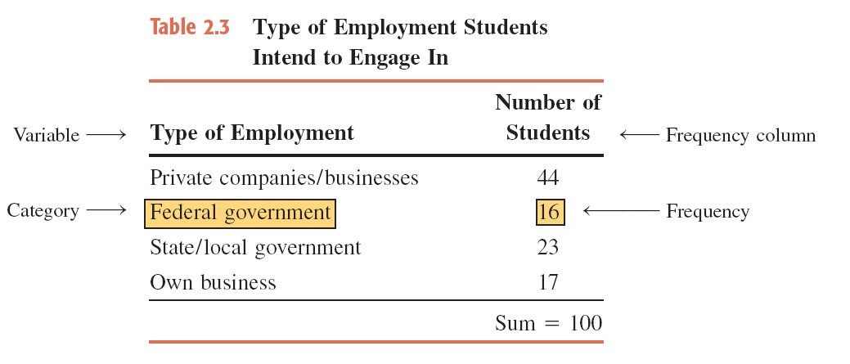
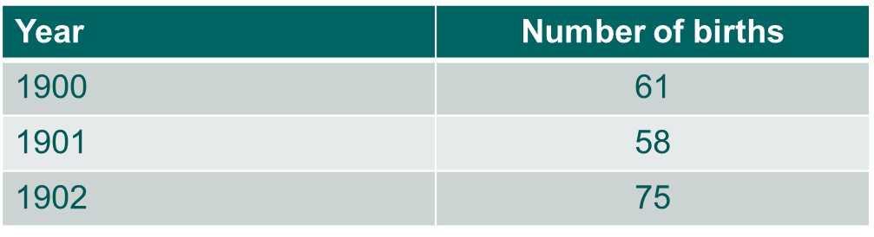
Examples
:
Exam Score | Frequency
70-79 | 3
80-89 | 8
90-99 | 5
100-109 | 2

Slide 7
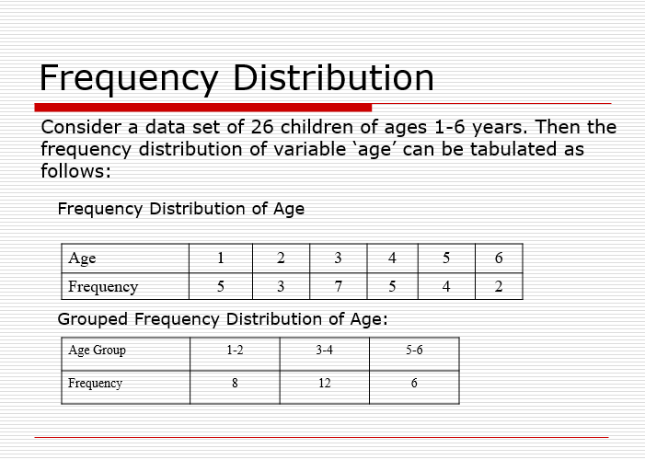

Slide 8
A sample of 30 persons who often consume donuts were asked what variety of donuts was their favourite. The responses from these 30 persons were as follows:
glazed | filled | other | plain | glazed | other
frosted | filled | filled | glazed | other | frosted
glazed | plain | other | glazed | glazed | filled
frosted | plain | other | other | frosted | filled
filled | other | frosted | glazed | glazed | filled

Slide 9
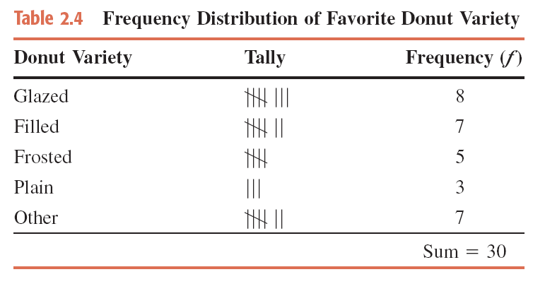
Construct a Frequency Distribution Table

Slide 10
Class Limits
Class limits are the boundaries of the intervals or classes in a frequency distribution. There are two types of class limits:
Lower Class Limit: This is the smallest value that belongs to a particular class interval. It defines the starting point of the interval.
Upper Class Limit: This is the largest value that belongs to a particular class interval. It defines the endpoint of the interval.
Class Interval | Lower Class Limit | Upper Class Limit
70-79 | 70 | 79
80-89 | 80 | 89
90-99 | 90 | 99
100-109 | 100 | 109

Slide 11
Class Interval
The difference between two connective lower class limits or two connective upper class limits or two connective lower class boundaries or two connective upper class boundaries is known as class interval it is denoted by “h”.
It is also known as class width/ Class height .
In the case of class boundaries if we subtract upper class boundary from the lower boundary of the same class we get class interval.

Slide 12
Class Mark
When we divide the sum of upper and lower class limits or sum of upper and lower class boundaries by 2 we get class mark.
It is denoted by X.
It is also known as Mid point.

Slide 13
CLASS BOUNDARIES
Class boundaries are points that lie halfway between the lower class limit of one interval and the upper class limit of the next interval in a frequency distribution. They are used to create histograms and frequency polygons.

Slide 14
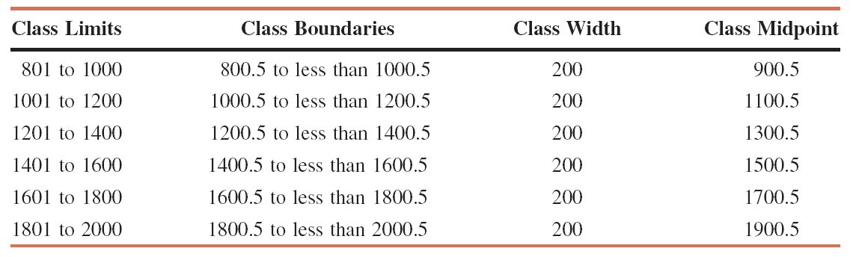

Slide 15
Relative Frequency
When we divide the frequency of a specific class by the sum of all the frequencies in a frequency distribution.
It is denoted by R.F or r.f.

Slide 16
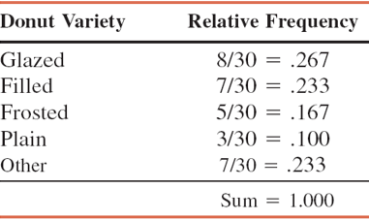
Example
Determine the relative frequency.

Slide 17
Cumulative Frequency
When we add the frequency of first class to the frequency of the next class we obtain cumulative frequency.
It is denoted by C.F.

Slide 18
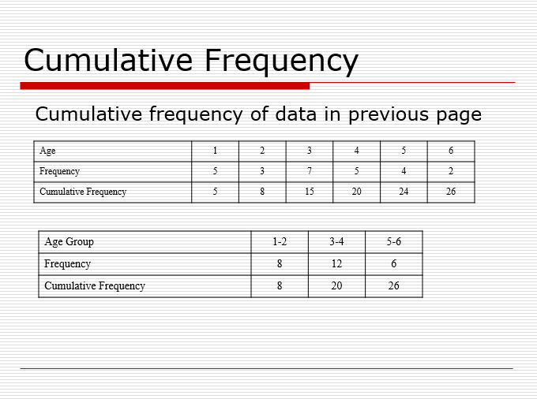

Slide 19
Cumulative Relative Frequency
When we divide the Cumulative frequency of a each class by the sum of all the frequencies in a frequency distribution we get Cumulative frequency distribution.
It is denoted by C.R.F or c.r.f.

Slide 20
Example
The following data give the total number of iPods® sold by a mail order company on each of 30 days. Construct a frequency distribution table.
8 | 25 | 11 | 15 | 29 | 22 | 10 | 5 | 17 | 21
22 | 13 | 26 | 16 | 18 | 12 | 9 | 26 | 20 | 16
23 | 14 | 19 | 23 | 20 | 16 | 27 | 16 | 21 | 14

Slide 21
The minimum value is 5, and the maximum value is 29. Suppose we decide to group these data using five classes of equal width. Then,
Now we round this approximate width to a convenient number, say 5. The lower limit of the first class can be taken as 5 or any number less than 5. Suppose we take 5 as the lower limit of the first class. Then our classes will be
5 – 9, 10 – 14, 15 – 19, 20 – 24, and 25 – 29

Slide 22
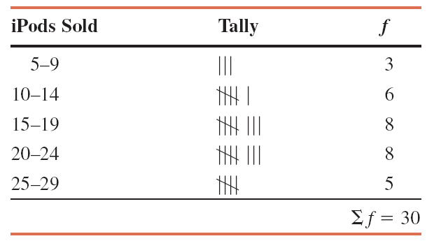
Table Frequency Distribution for the Data on iPods Sold

Slide 23
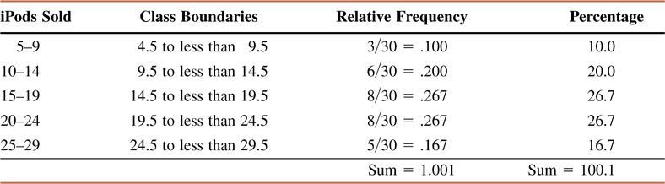
Relative Frequency and Percentage Distributions

Slide 24
Construction of grouped frequency distribution
The following points should be kept in mind while constructing grouped frequency distribution.
Decide the number of classes into which the data to be grouped.
Find the range of the data.
Divide the range by the number of classes (Class interval).
Decide where to locate the lower class limit.
Determine the remaining class limits.
Divide the data into appropriate classes.
Finally total the frequency column.

